Slide 1

Antibiotic-Associated Diarrhea
Gut Microbiome Diversity Analysis
Team Members :
Shaimaa Ammar
Mahmoud Amin
Ali Marzban
Abdelrahman Lotfy

Slide 2
Study Overview
SAMPLE SIZE
DIVERSITY METRICS
335 Patients
Shannon Index: Measures species diversity accounting for abundance
Chao1 Index: Estimates total species richness
ANTIBIOTIC CLASSES
Jaccard Distance: Measures compositional change between Day 1 and Day 6
FQN (56) • OBL (111) • PBL (168)
KEY QUESTION
CLINICAL OUTCOMES
Do different antibiotic classes affect gut microbiome diversity differently?
AAD (22) • CDI (5) • ND (308)

Slide 3
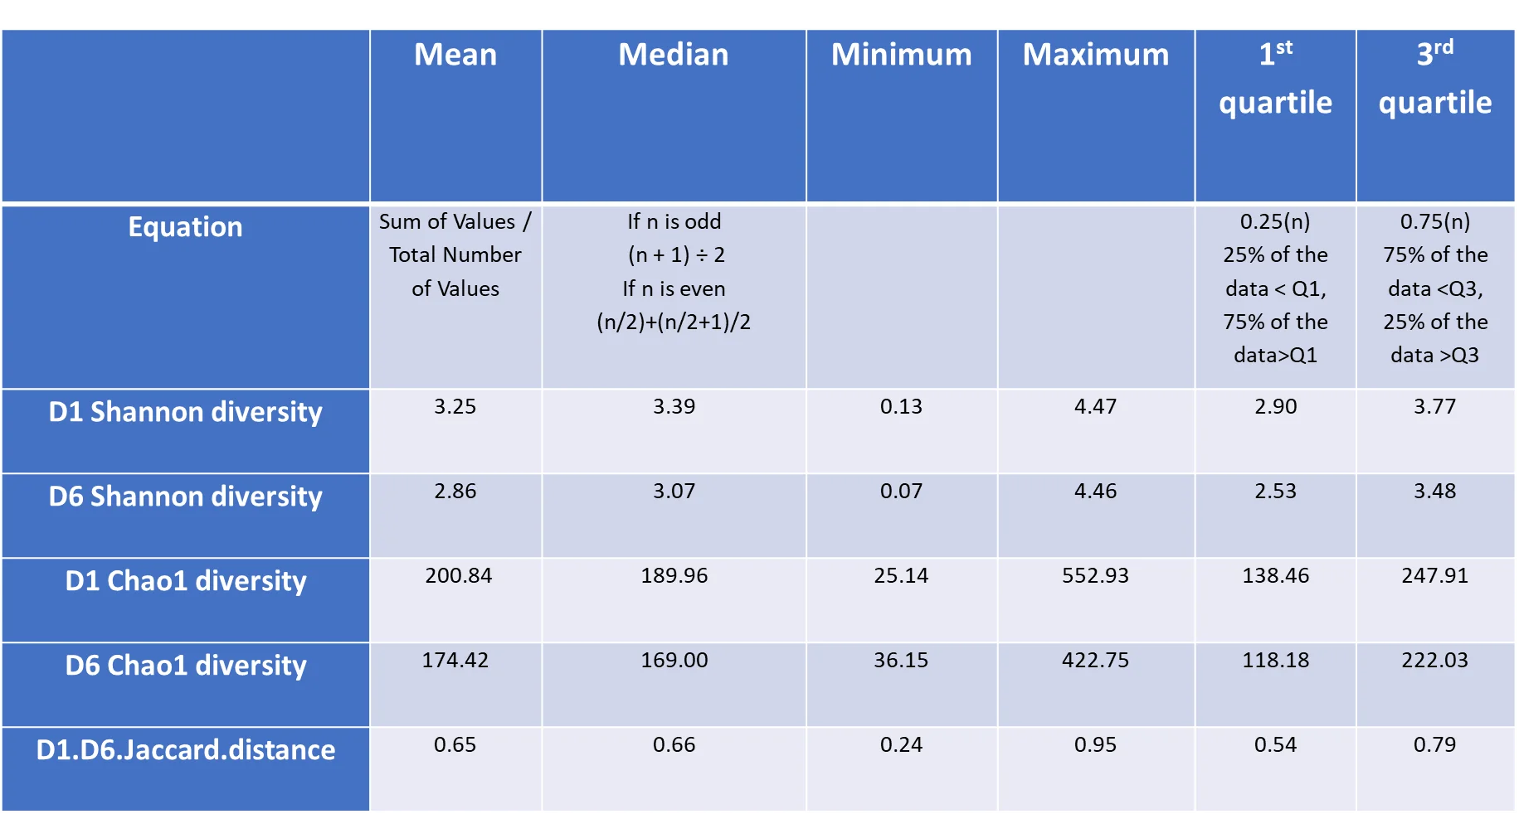
Descriptive Statistics
n = 335 patients

Slide 4
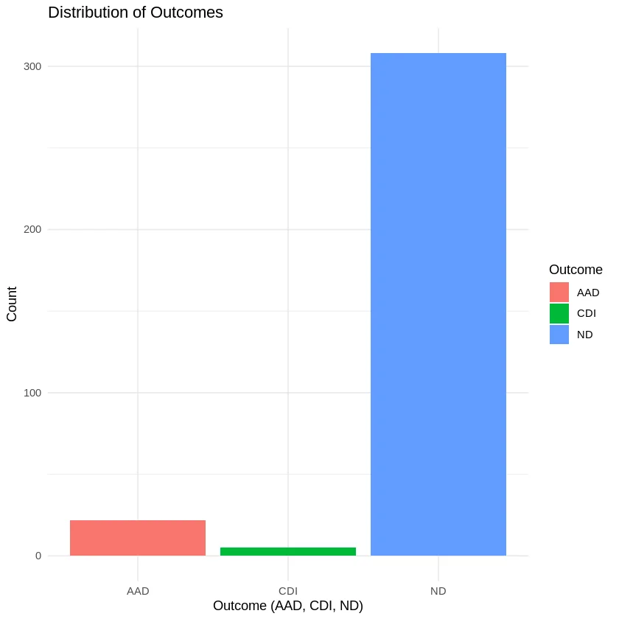
Distribution of Outcomes
No Diarrhea (ND)
308 (91.9%)
AAD
22 (6.6%)
CDI
5 (1.5%)

Slide 5
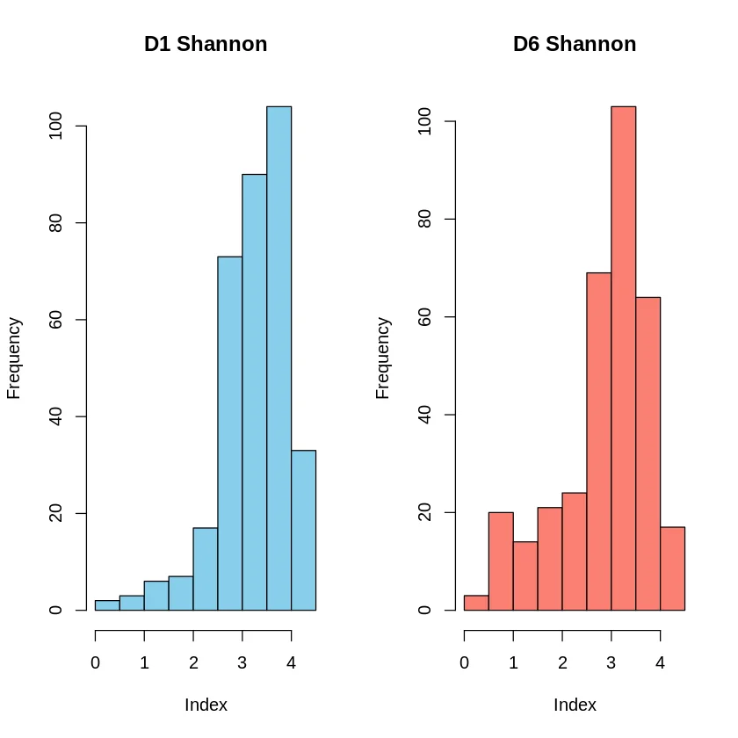
Shannon Diversity Distribution
DAY 1
Mean: 3.25
Median: 3.39
Range: 0.13 - 4.47
DAY 6
Mean: 2.86
Median: 3.07
Range: 0.07 - 4.46
Diversity decreased from Day 1 to Day 6

Slide 6
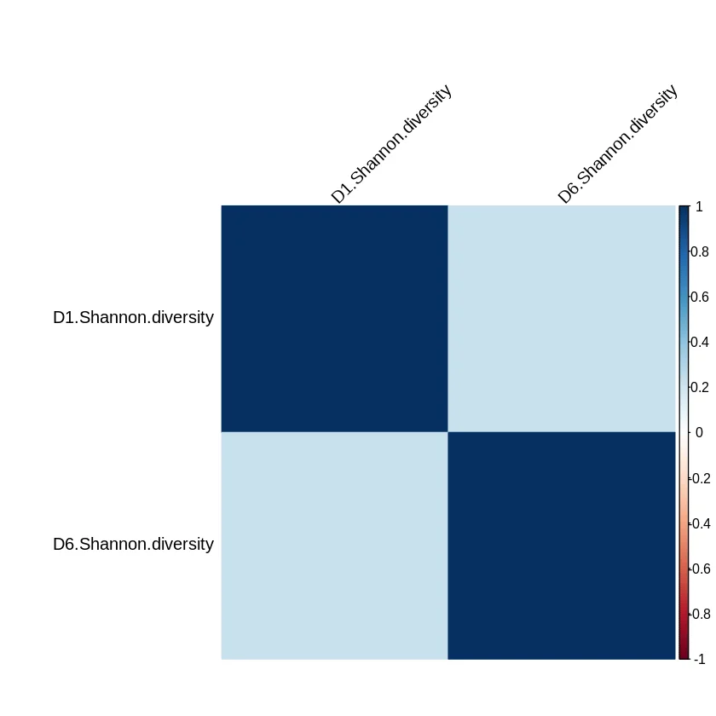
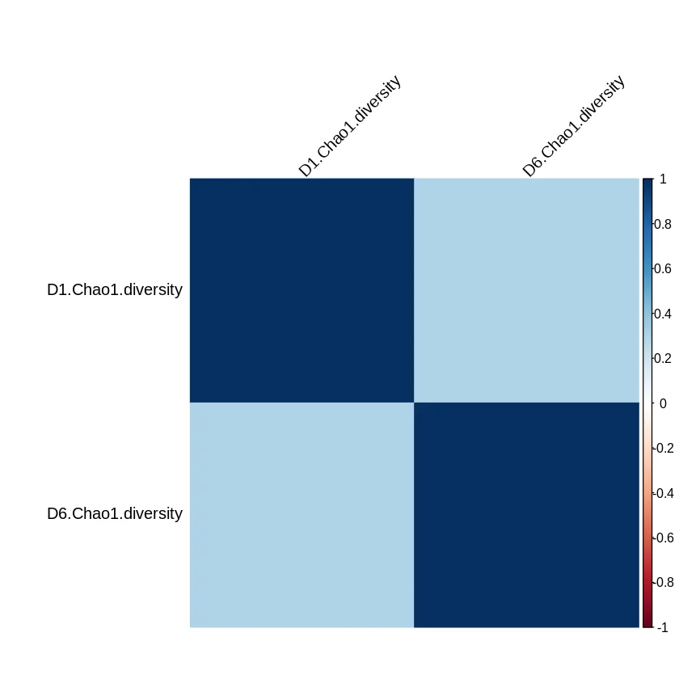
Correlation Analysis
Shannon Diversity
Chao1 Diversity
Pearson r = 0.221
Pearson r = 0.303

Slide 7
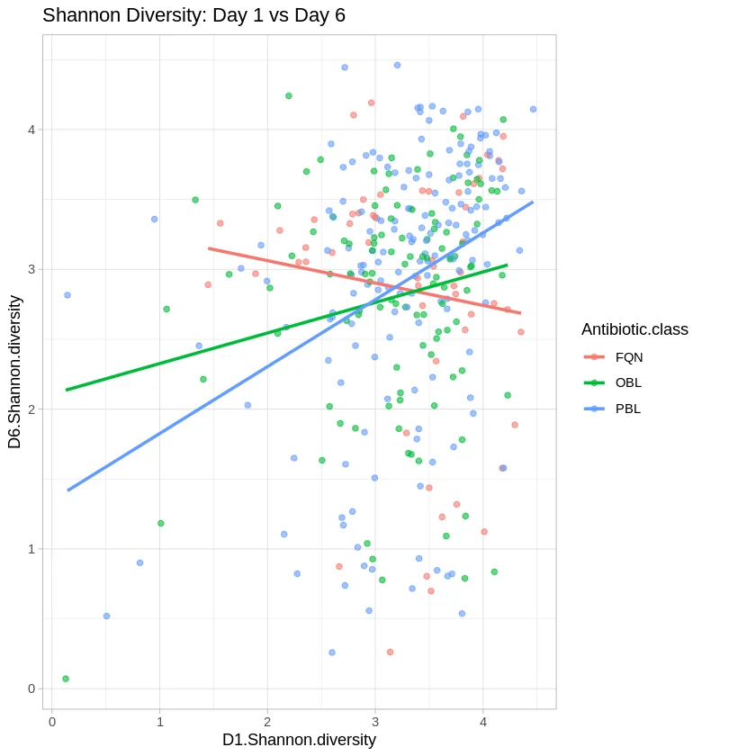
Shannon Diversity: Day 1 vs Day 6
FQN (n=56)
OBL (n=111)
PBL (n=168)

Slide 8
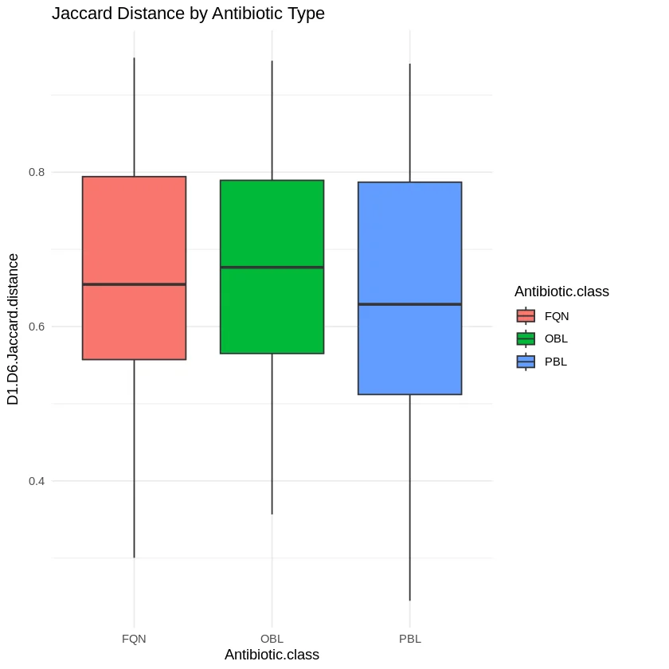
Jaccard Distance by Antibiotic Type
Overall Mean
0.65
Range: 0.24 - 0.95
By Antibiotic Class
FQN: 0.65 ± 0.020
OBL: 0.67 ± 0.013
PBL: 0.64 ± 0.013
No outliers detected in Jaccard distance

Slide 9
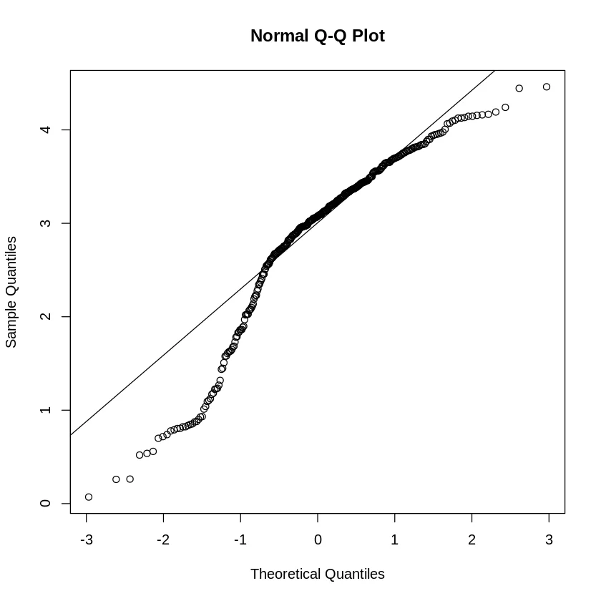
Testing for Normality
Q-Q Plot: D6 Shannon Diversity
SHAPIRO-WILK TEST
D6 Shannon Diversity
Tests whether data follows normal distribution
INTERPRETATION
Q-Q plot shows approximate normality with slight deviations at tails

Slide 10
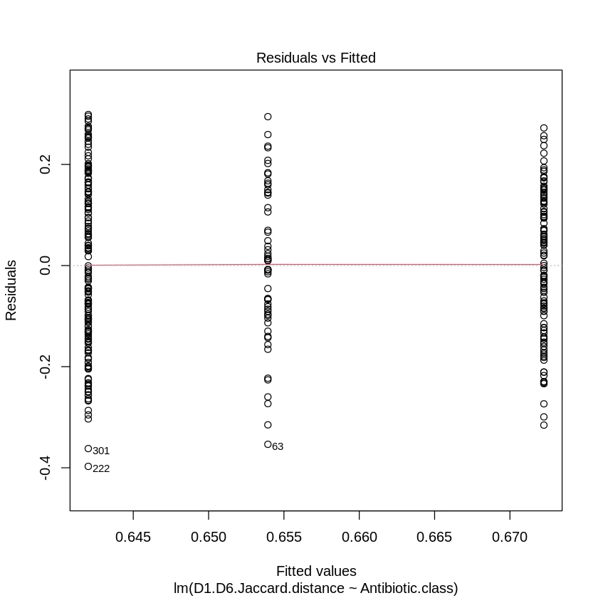
Testing for Homoscedasticity
Residuals vs Fitted Values
BARTLETT TEST
Jaccard Distance ~ Antibiotic Class
K² = 3.865
df = 2, p = 0.145
CONCLUSION
p > 0.05: Equal variances assumed

Slide 11
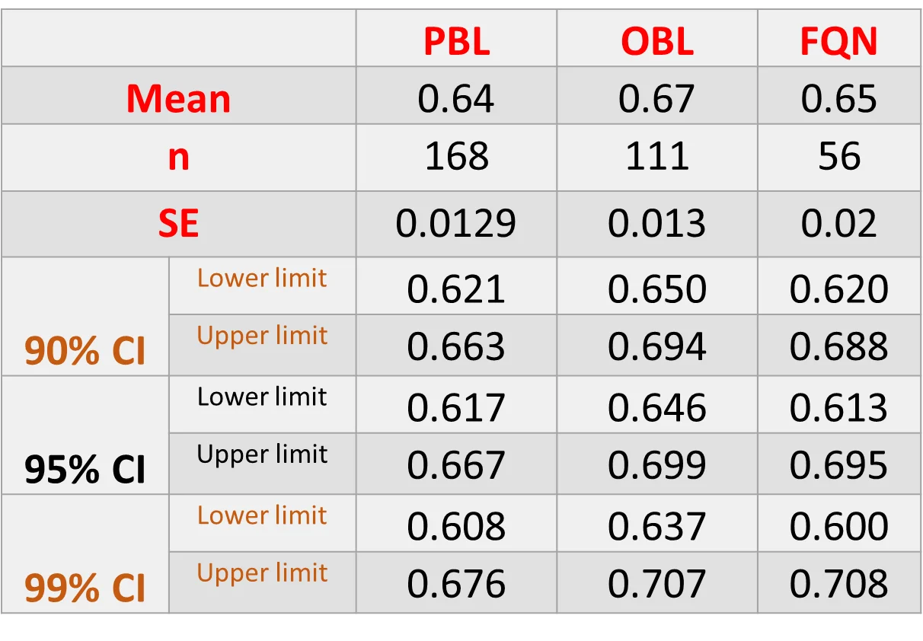
Confidence Intervals: Jaccard Distance

Slide 12
Hypothesis Testing: T-Tests
TEST 1: TWO-SAMPLE T-TEST
TEST 2: WELCH T-TEST
D6 Shannon: CDI vs ND
Jaccard: OBL vs FQN
t = 0.364, df = 311
t = -0.752, df = 102.69
p = 0.716
p = 0.454
95% CI: [-0.644, 0.936]
95% CI: [-0.067, 0.030]
No significant difference (p > 0.05)
No significant difference (p > 0.05)

Slide 13
ANOVA: Jaccard Distance by Antibiotic Class
TUKEY HSD POST-HOC
ONE-WAY ANOVA
Sum of Squares (Treatment)
0.061
F-value
df
p-value
1.253
2, 332
0.287
CONCLUSION
No significant differences between antibiotic classes (all p > 0.05)

Slide 14
Linear Model: Jaccard Distance
MODEL COEFFICIENTS
MODEL FIT
R²
Adj R²
0.007
0.002
Residual SE: 0.156
95% CONFIDENCE INTERVALS
INTERPRETATION
Antibiotic class explains <1% of variance in Jaccard distance
Model F(2,332) = 1.253, p = 0.287

Slide 15
Key Findings & Conclusions
DIVERSITY CHANGES
ANTIBIOTIC COMPARISON
Shannon diversity decreased from Day 1 (mean: 3.25) to Day 6 (mean: 2.86)
No significant differences in Jaccard distance between FQN, OBL, and PBL classes (ANOVA p=0.287)
CORRELATION
CDI vs ND
Weak positive correlations between D1 and D6 (Shannon r=0.22, Chao1 r=0.30)
No significant difference in D6 Shannon diversity between CDI and ND groups (p=0.716)
CLINICAL OUTCOMES
MAIN CONCLUSION
91.9% had no diarrhea, 6.6% developed AAD, 1.5% developed CDI
Microbiome compositional changes occur regardless of antibiotic class, suggesting similar disruption patterns across treatment types

